Slide 1
QUARTERLY VOC REVIEW
DATE

Slide 2
INTRODUCTION
Add your introduction copy here

Slide 3
TABLE OF CONTENTS
Recap of Quarter’s Goals
Overview of Previous Quarter
Channels
Number of Surveys
Main Themes Identified
Changes implemented.
Overview of This Quarter
Overview of metrics and surveys for the quarter
Channels
Number of Surveys
Number of Survey responses
Main Themes Identified
Performance
Customer Feedback Topic Themes
Achievements
Implemented programs
Staff retention
Goals for the Quarter to follow
Summary and closing remarks

Slide 4
RECAP OF Q# (Previous Q)
CHANNELS
SURVEYS SENT
RESPONSE RATE
Which channels are you using to survey?
How many surveys did you send?
How many surveys did you send?

Slide 5
RECAP OF Q# (Previous Q)
AVERAGE TIME TO
RESOLVE
THEMES IDENTIFIED
FIXES IMPLEMENTED
What is the median time that customers experienced to resolve issues?
What are the main themes in dissatisfaction or satisfaction
What measures were taken to address these themes?

Slide 6
GOALS FOR QUARTER
AGENT VoC PERFORMANCE
REGIONAL VoC PERFORMANCE
FIRST RESPONSE RESOLUTION
NPS Score Average
Average CSAT
Score
Goal:

Slide 7
Q# MILESTONES
AVERAGE TIME TO RESOLVE
CHANNELS
SURVEYS SENT
RESPONSE RATE
Which channels are you using to survey?
How many surveys did you send?
How many surveys did you send?
What is the median time that customers experienced to resolve issues?

Slide 8
PERFORMANCE
NOTE: Please duplicate or remove pages as needed to drill down into your regional offices, departmental offices etc.

Slide 9
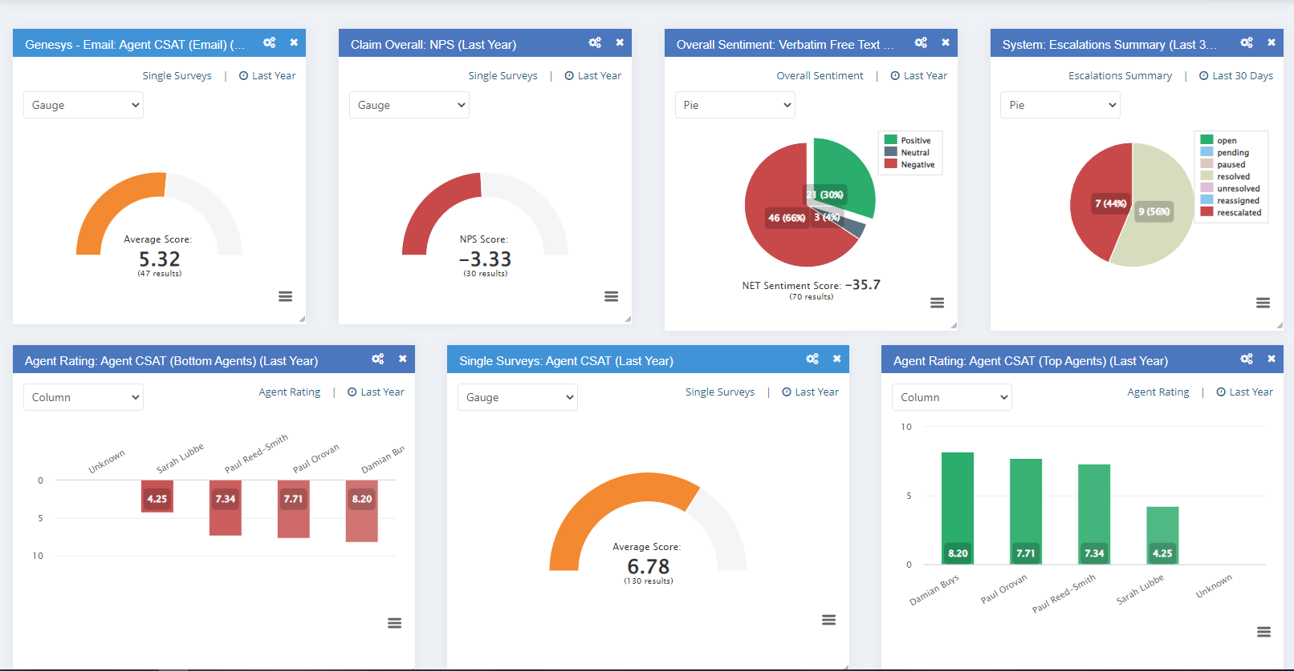
PERFORMANCE OVERVIEW

Slide 10
PERFORMANCE: Contact Centre Call Resolution Averages (CRA)
Centre Name
CRA %
Centre Name
CRA %
Centre Name
CRA %
MEDIAN %
Centre Name
CRA %
Centre Name
CRA %
Centre Name
CRA %

Slide 11
PERFORMANCE: Contact Centre Net Promoter Score (NPS)
Centre Name
NPS
Centre Name
NPS
Centre Name
NPS
MEDIAN
Centre Name
NPS
Centre Name
NPS
Centre Name
NPS

Slide 12
PERFORMANCE: Contact Centre Net Retention Index (NRI)
Centre Name
NPS
Centre Name
NPS
Centre Name
NPS
MEDIAN
Centre Name
NPS
Centre Name
NPS
Centre Name
NPS

Slide 13
STATISTICAL CORRELATION BETWEEN AGENT PERFORMANCE AND NPS BY CONTACT CENTRE

Slide 14
FEEDBACK THEMES

Slide 15
THEME 1:
THEME 2:
COMPLAINT:
COMPLAINT:
SOLUTION:
SOLUTION:
OUTCOME:
OUTCOME:

Slide 16
THEME 3:
THEME 4:
COMPLAINT:
COMPLAINT:
SOLUTION:
SOLUTION:
OUTCOME:
OUTCOME:

Slide 17
ACHIEVEMENTS

Slide 18
TRAINING IMPLEMENTED

Slide 19
STAFF RETENTION

Slide 20
OTHER

Slide 21
GOALS FOR QUARTER #
AGENT VoC PERFORMANCE
REGIONAL VoC PERFORMANCE
FIRST RESPONSE RESOLUTION
NPS Score Average
Average CSAT
Score
Goal:

Slide 22
SUMMARY & CLOSING STATEMENTS

